Slide 1
ANLY580 Module 2-1 Multilingual Computing
Linda Moreau
(vanguill@georgetown.edu)
September 17, 2019

Slide 2
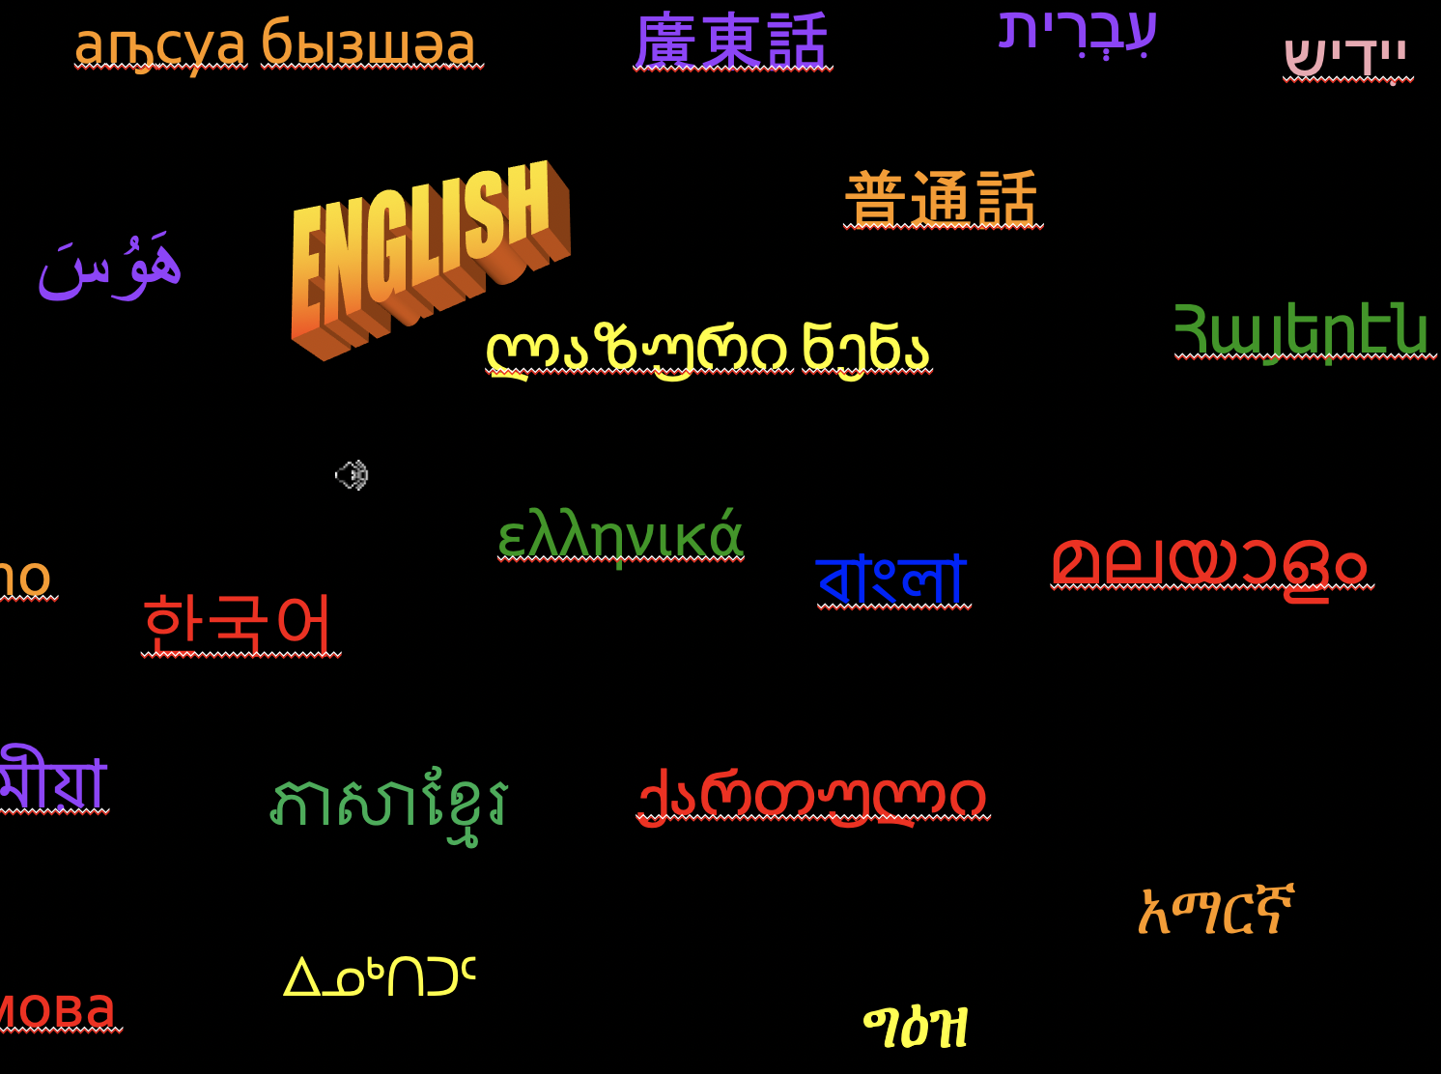
Multilingual NLP
a brief introduction to doing data science in different languages

Slide 3
Introductions
MY
DEGREE
MY
JOB
computer science & programming
artificial intelligence
data science
computational *science
natural language processing (NLP)
programming
algorithms
visualization
*LINGUISTICS
scientific method
machine learning
math & statistics
Notes:
Computational linguistics is the use of computational techniques to study linguistic phenomena with the goal of furthering the science of linguistics. Natural language processing is the creation and application of algorithms aimed to process a linguistic signal but for purposes other than linguistics, e.g. better targeted marketing, studying public sentiment, performing psychological assessments. NLP draws from a similar set of tools and techniques as related fields such as Artificial Intelligence (AI) and data science, but NLP professionals should bring a strong knowledge of linguistics and languages as part of their skillset.
See this discussion by Jacob Eisner: https://www.quora.com/How-is-computational-linguistics-different-from-natural-language-processing

Slide 4
Language and script identification
абаза бызшва
аҧсуа бызшәа
廣東話
עִבְרִית
ײִדיש
ENGLISH
普通話
アイヌ イタク
هَوُسَ
ლაზური ნენა
Հայերէն
Нохчийн мотт
ελληνικά
italiano
বাংলা
മലയാളം
العربية
한국어
Русский язык
Tiếng Việt
অসমীয়া
ភាសាខ្មែរ
ქართული
አማርኛ
Беларуская мова
ᐃᓄᒃᑎᑐᑦ
ግዕዝ
check out more: http://trekkingnepaltourism.blogspot.com/2012/09/language-names.html

Slide 5
Language and script identification
абаза бызшва
аҧсуа бызшәа
廣東話
עִבְרִית
ײִדיש
Abaza
Cantonese
Hebrew
Abkhaz
Yiddish
ENGLISH
普通話
アイヌ イタク
هَوُسَ
Mandarin
Ainu
ლაზური ნენა
Հայերէն
Hausa
Нохчийн мотт
Laz (Lazuri nena)
Armenian
Chechen
ελληνικά
italiano
বাংলা
മലയാളം
العربية
Italian
한국어
Greek
Malayalam
Arabic
Bengali
Korean
Русский язык
Tiếng Việt
অসমীয়া
ភាសាខ្មែរ
ქართული
Russian
Vietnamese
Assamese
Khmer
Georgian
አማርኛ
Беларуская мова
ᐃᓄᒃᑎᑐᑦ
Amharic
ግዕዝ
Byelorussian
Inuktitut
Ge'ez
check out more: http://trekkingnepaltourism.blogspot.com/2012/09/language-names.html

Slide 6
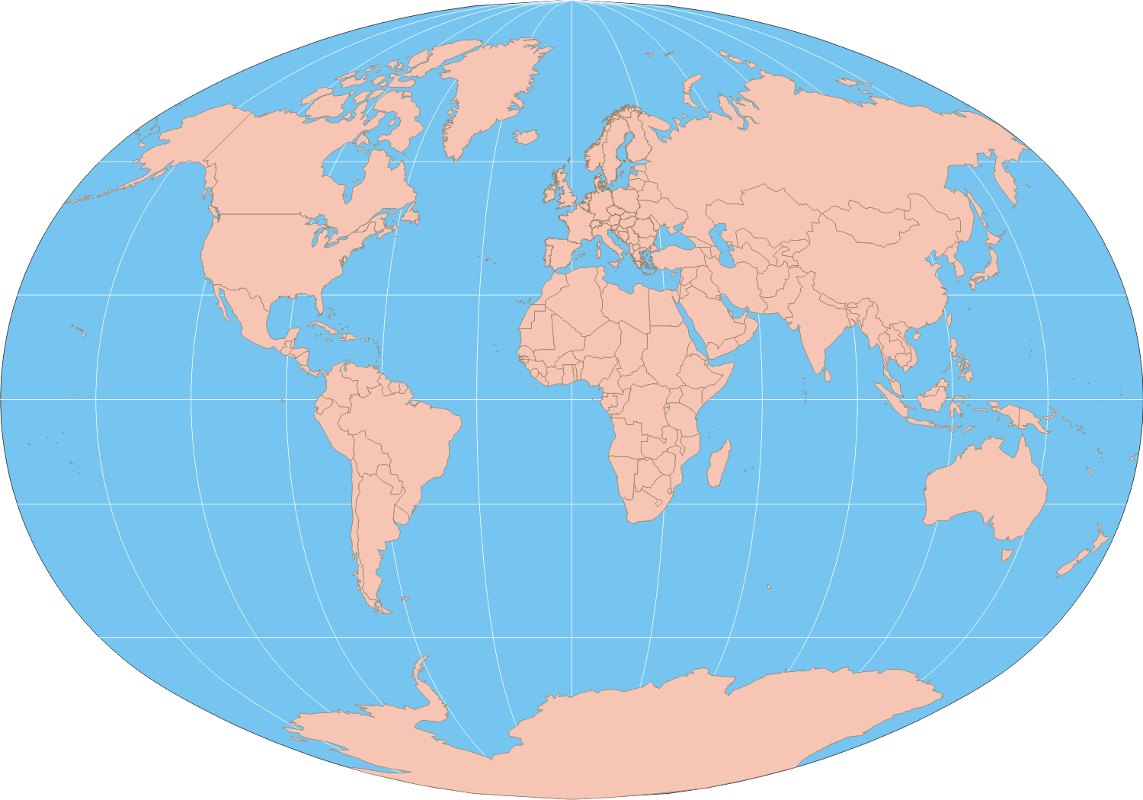

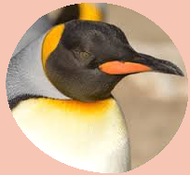
There are about
6,909 languages in the world!
Halló
Góan dag
(Icelandic)
გამარჯობა
“gamarjoba”
(Georgian)
Aang (Aleut)
Hyvää päivää
(Finnsih)
Привет
“preevyet”
(Russian)
Salut (French)
שלום
“Shalom”
(Hebrew)
안녕
“annyeong”
(Korean)
Buongiorno
(Italian)
你好
“nǐ hǎo”
(Mandarin
Chinese)
Hello
(English)
مرحبا
“marhaba”
(Arabic)
नमस्ते
“namastay”
(Hindi)
Hola
(Spanish)
Kedụ
(Igbo)
سلام
“Salam”
(Persian Farsi)
Agandi
(Nkore)
Olà
(Portuguese)
Molo
(Xhosa)
Hi!
(English)
Γειά σου
“Ya soo”
(Greek)
สวัสดี
“sà-wàt-dee”
(Thai)
tweeeeet
(Penguin)

Slide 7

Language and Script Identification
http://localhost:8888/notebooks/Language_Identification.ipynb

Slide 8
What must you know to process a language?
Let's start with a
quick
top-down look at
multi-lingual NLP
Then take a detailedbottom-up look at low-level NLP
I often start with: https://omniglot.com andhttps://www.ethnologue.com/
Notes:
Cultural context (pragmatics)
Structure (word order, discourse structure)
How to compare words (similarity, matching)
How/whether to identify word forms (lemmatization, stemming)
How to find words (tokenization)
How to find characters (writing system and encoding). [or phonemes if audio signal)

Slide 9
NLP that deals with meaning
Machine Translation, Sentiment analysis, Summarization, User Profiling
Challenges
Word sense selection
right
can
Word order
Mon ancien ami. → 'My longtime friend.'
Mon ami ancien. → 'My extremely aged friend.'
Syntactic "gaps" or mismatches
silly
Idioms
It's raining cats and dogs.
meaning
meaning
context
discourse
sentence
word
character
Notes:
Cultural context (pragmatics)
Structure (word order, discourse structure)
How to compare words (similarity, matching)
How/whether to identify word forms (lemmatization, stemming)
How to find words (tokenization)
How to find characters (writing system and encoding). [or phonemes if audio signal)

Slide 10
Context and culture
Words don't always tell the whole story
Cultural understanding is often necessary
Sentiment analysis
C'est pas terrible. (literal: It's not terrible. actual: It's awful.)
C'est pas mal. (literal: It's not bad. actual: It's good.)
Profiling
Moral foundations
Psychological states
Tightness vs. looseness
Dialog
Indirect speech acts. (literal statement: "It's so cold in here, " he said as he stared at the open window. His teacher immediately closed the window with a clack". illocutionary force: request)
Sarcasm
"I so love getting up at at 5am on a dark winter day!"
meaning
context
context
discourse
sentence
word
character
Notes:
Cultural context (pragmatics)
Structure (word order, discourse structure)
How to compare words (similarity, matching)
How/whether to identify word forms (lemmatization, stemming)
How to find words (tokenization)
How to find characters (writing system and encoding). [or phonemes if audio signal)

Slide 11
Discourse norms
Assumptions we make for processing one language may not hold true for another
Narrative or dialogue structure
Automatic summarization
American news text often puts a summary or status update up front, then unrolls the details somewhat chronologically
Dialogue systems
Get straight to the point, or engage in formulaic politeness
meaning
context
discourse
discourse
sentence
word
character
Notes:
Cultural context (pragmatics)
Structure (word order, discourse structure)
How to compare words (similarity, matching)
How/whether to identify word forms (lemmatization, stemming)
How to find words (tokenization)
How to find characters (writing system and encoding). [or phonemes if audio signal)

Slide 12
Sentence structure
Each language presents different challenges
English
periods are in sentences, abbreviations, url's, numbers,…
Chinese
Has an unambiguous full stop, but it is often not used
" Chinese sentence segmentation is viewed as the detection of loosely coordinated clauses separated by commas. " (Xue and Yang, 2011)
https://www.aclweb.org/anthology/P11-2111
Thai
Doesn't use much punctuation, rarely puts spaces between words.
"Thai language text presents challenges for integration into large-scale multilanguage statistical machine translation (SMT) systems, largely stemming from the nominal lack of punctuation and inter-word space."(Slayden et al. 2010) https://www.aclweb.org/anthology/W10-3602
meaning
context
discourse
sentence
sentence
word
character
Notes:
Cultural context (pragmatics)
Structure (word order, discourse structure)
How to compare words (similarity, matching)
How/whether to identify word forms (lemmatization, stemming)
How to find words (tokenization)
How to find characters (writing system and encoding). [or phonemes if audio signal)

Slide 13
What is a word?
What is a token? Are words and tokens the same?
English
meaning
Jon's #1 favorite web site for U2, http://www.u2.com/, was written on the black board.
context
discourse
German
compounding
Korean
agglutination
Chinese
no white spaces
Korean
agglutination
sentence
word
word
character
Notes:
Cultural context (pragmatics)
Structure (word order, discourse structure)
How to compare words (similarity, matching)
How/whether to identify word forms (lemmatization, stemming)
How to find words (tokenization)
How to find characters (writing system and encoding). [or phonemes if audio signal)

Slide 14
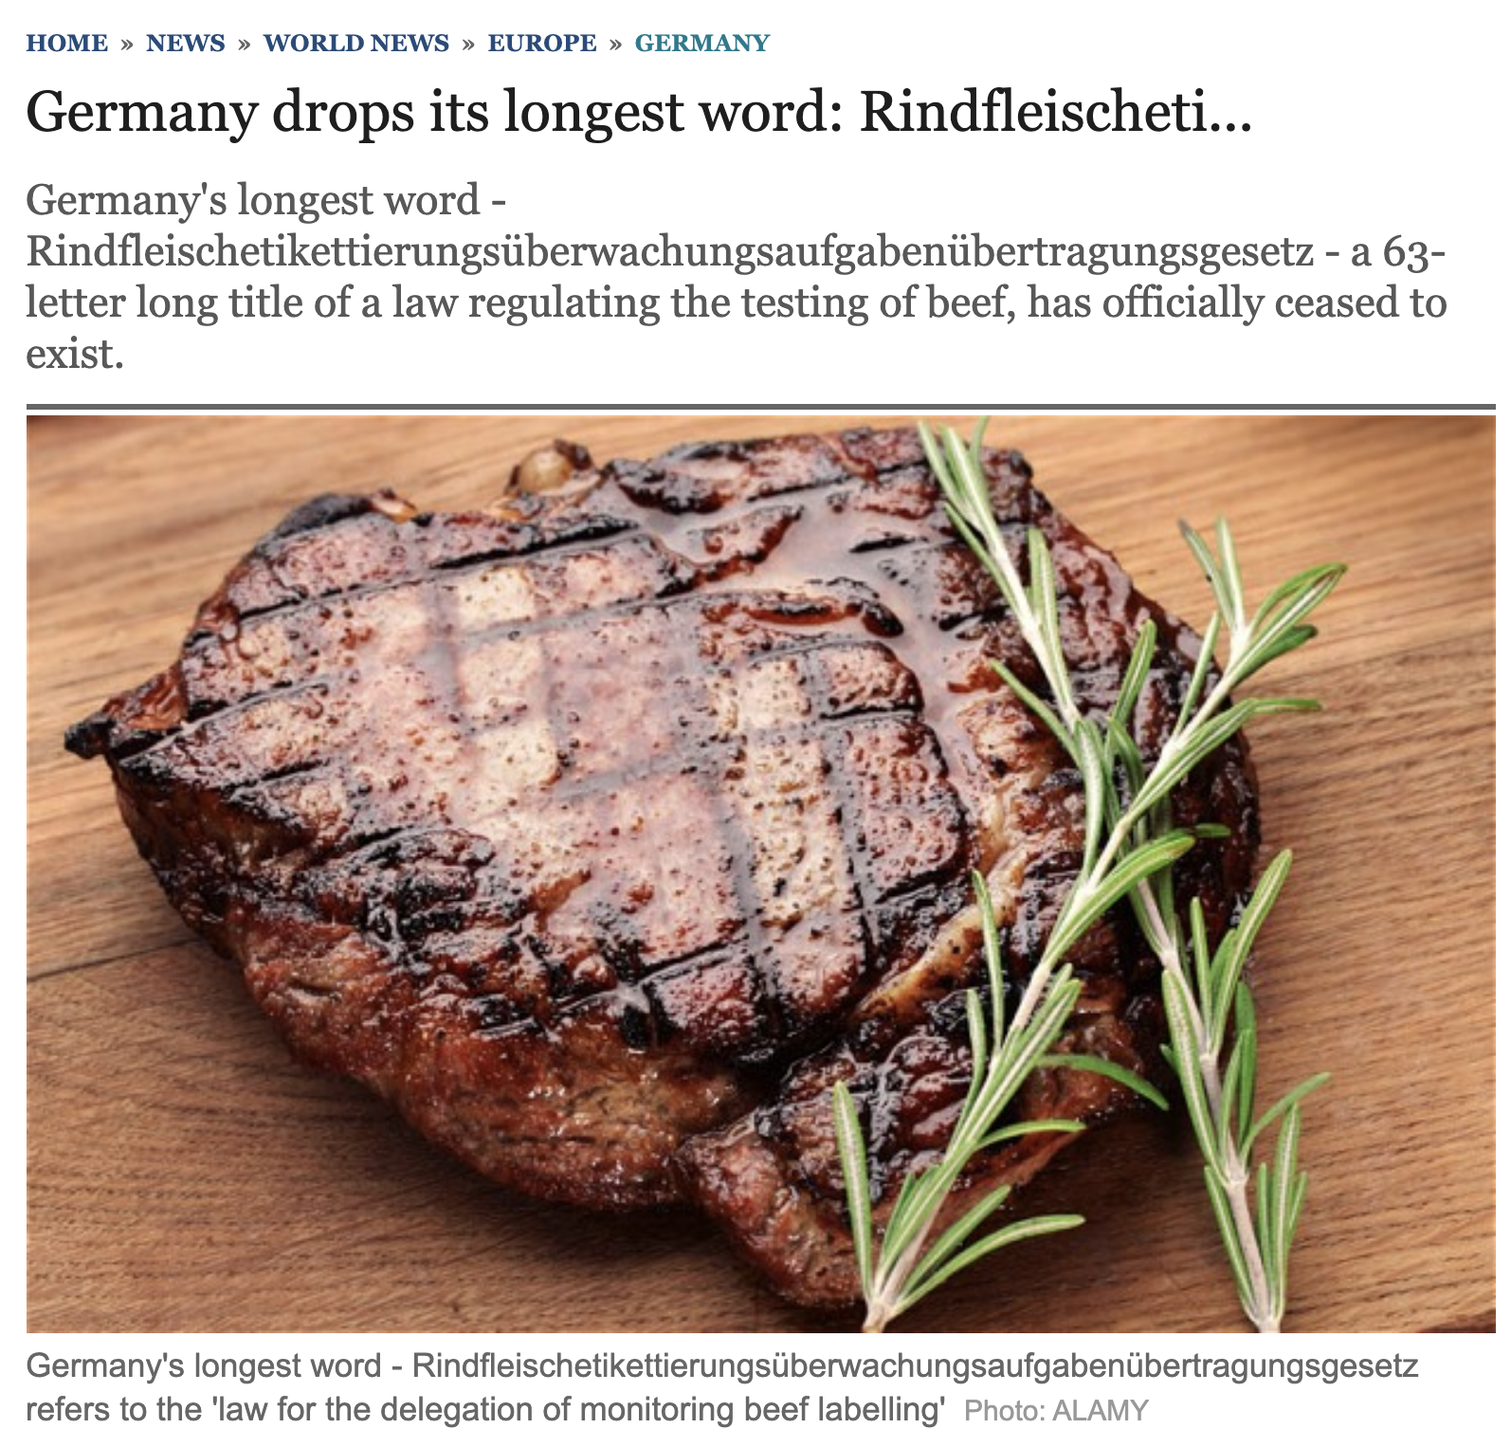
Rindfleischetikettierungsüberwachungsaufgabenübertragungsgesetz
– 63 letters long
meaning
context
discourse
sentence
word
word
character
https://www.telegraph.co.uk/news/worldnews/europe/germany/10095976/Germany-drops-its-longest-word-Rindfleischeti....html

Slide 15
What is a morpheme?
Morphemes are parts of words
prefixes, suffixes, infixes, stems, roots
meaning
Russian
case, tense, aspect, gender
Arabic
roots and stems
Chinese
usually we say no morphology, but…?
(http://www-personal.umich.edu/~duanmu/RevPackard02.pdf)
Korean
agglutination
context
discourse
sentence
Statistical techniques may approximate with
n-grams
byte pair encodings
…
word
word
character
Notes:
Cultural context (pragmatics)
Structure (word order, discourse structure)
How to compare words (similarity, matching)
How/whether to identify word forms (lemmatization, stemming)
How to find words (tokenization)
How to find characters (writing system and encoding). [or phonemes if audio signal)

Slide 16
What is a morpheme?
Morphemes are sub-parts of words that combine according to language-specific rules
meaning
adj+’-ly’==adv
context
a n t i c o n s t i t u t i o n a l l y
discourse
‘anti-’ + adv = adv<+neg>
Noun + ‘-al’ == adj
sentence
word
word
character
Notes:
Cultural context (pragmatics)
Structure (word order, discourse structure)
How to compare words (similarity, matching)
How/whether to identify word forms (lemmatization, stemming)
How to find words (tokenization)
How to find characters (writing system and encoding). [or phonemes if audio signal)

Slide 17
What is a character?
And how can you find one?
simple characters: e
modified characters: é ← one character or two?
ligature characters: æ ← one character or two?
क्र. ← one character or three क + ् + र
contextual forms : ﺲ ﺴ س ﺳ ← four characters or one?
meaning
context
discourse
sentence
abstract character "Arabic Letter Seen" →
isolated glyph form س
initial glyph form ﺳ
medial glyph form ﺴ
final glyph form ﺲ
word
character
character

Slide 18
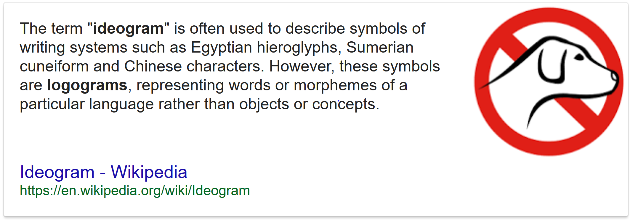
LScript Types
Alphabetic
Abjad
Abugida
Syllabic
Logographic
Often the writing system for a language is a combination of multiple scripts, e.g Japanese
https://en.wikipedia.org/wiki/Writing_system
Notes:
The set of abstract characters covered is the character repertoire,

Slide 19
Encoding detection and conversion
Now let'start at the bottom and code our way up to the middle
http://localhost:8888/notebooks/Encodings.ipynb

Slide 20
Encodings explained
Digital Typography: Representing written language in a computer
Terms
Character Repertoires
Abstract Characters
Coded Character Sets
Character Encodings
Code Points
Glyphs
Fonts
https://www.w3.org/International/questions/qa-what-is-encoding
https://www.smashingmagazine.com/2012/06/all-about-unicode-utf8-character-sets/

Slide 21
Character Repertoires
A character repertoire is an unordered set of abstract characters used to represent a writing system
Some writing systems use multiple scripts
alphabet
syllabary
digits
punctuation
symbols
diacritics
г ж
…
3
c
y
RUSSIAN
2
ENGLISH
2
б
3
x
а
a
d
…
в
w
1
1
e
ぅ ぁ
b
ف
д
…
0
0
3
z
٢
ARABIC
2
٤
JAPANESE
3
ش
2
ご
ا
ت
٣
…
1
١
に
日
本
1
0
ب
ウ

Slide 22
Abstract Characters
The terms abstract symbol or abstract character provide a way of referring to a symbol, such as a letter of the alphabet or a numeric digit, without making any specific claim as to the shape it takes or the number used to represent it digitally.
Often referred to with descriptive phrases
"LATIN CAPITAL LETTER B"
"ARMENIAN CAPITAL LETTER OH"
"GREEK SMALL LETTER MU"
Notes:
The set of abstract characters covered is the character repertoire,

Slide 23
Coded Character Set
A coded character set, or character encoding, is a mapping that assigns a numeric value to each abstract character in a character repertoire.
ASCII Numeric Code | Abstract Character
64 | Ampersand
65 | Latin Capital Letter A
66 | Latin Capital Letter B
67 | Latin Capital Letter C
Code Point
A few coded characters from the ASCII character encoding
See: http://en.wikipedia.org/wiki/Character_encoding for a thorough discussion

Slide 24
Character Encodings, Examples
American Standard Code for Information Interchange (ASCII)
pronounced /æ.ski /
represents the English character set with characters in English alphabetical order
Latin script languages such as
English, French, German, Spanish, etc…

Slide 25
Character Encodings, Examples
Unicode
Arabic
Hindi
Russian
Windows 1256
ISO 8859-6
Windows-1251
ISCII
Windows-1251
ISO 8859-5
KOI-7
KOi-8
MIK …
Korean
Chinese
KS X 1001
EUC-KR
ISO-2022-KR
EUC-JIS
Vietnamese
Simplified
Traditional
VSCII
GB2312
GBK
GB 18030
EUC-JIS
BIG5
Microsoft Code page 950
HKSCS (~Cantonese)
Japanese
EUC-JIS
Shift-JIS
JIS-X
ISO 2022-JP
https://en.wikipedia.org/wiki/Character_encoding

Slide 26
Unicode Standard
Universal Character Set (UCS)
A character encoding standard that maps code points to abstract characters
Unicode Transformation Format (UTF)
Specific implementations of Unicode that user different numbers of bytes and bits to represent code points
UTF-1 — a retired predecessor of UTF-8, maximizes compatibility with ISO 2022, no longer part of The Unicode Standard
UTF-7 — a relatively unpopular 7-bit encoding, often considered obsolete (not part of The Unicode Standard but rather an RFC)
UTF-8 — an 8-bit variable-width encoding which maximizes compatibility with ASCII. UTF-8 uses one to four bytes per code point and, being compact for Latin scripts and ASCII-compatible, provides the de facto standard encoding for interchange of Unicode text.
UTF-EBCDIC — an 8-bit variable-width encoding, which maximizes compatibility with EBCDIC. (not part of The Unicode Standard)
UTF-16 — a 16-bit, variable-width encoding
UTF-32 — a 32-bit, fixed-width encoding
http://en.wikipedia.org/wiki/Unicode

Slide 27
Character Encodings, Issues
One character repertoire, many possible encodings
Character | Decimal Code Point | Standard
Ж | 182 | ISO/IEC 8859-5
Ж | 214 | KOI-8R
Ж | 198 | Windows 1251
Ж | 1046 | Unicode 1.1
Code points for "Russian Capital Letter Zhe" under different character encoding standards

Slide 28
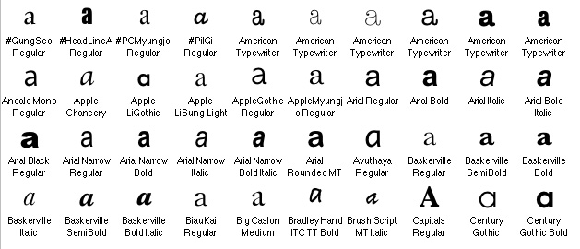
Glyphs
A Glyph is the graphical representation or shape used to display an abstract character or part of an abstract character, either on a screen or a printer
Some glyphs used to represent the abstract character "Latin letter a"
Image from http://www.tei-c.org/release/doc/tei-p5-doc/en/html/CH.html

Slide 29
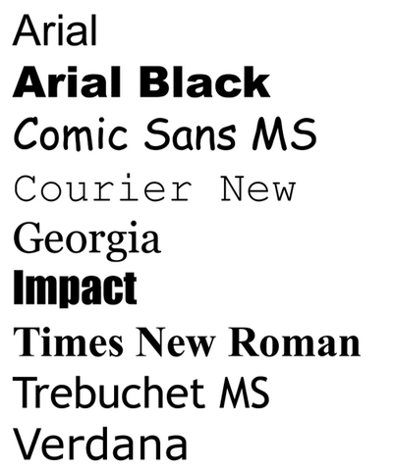
Fonts
A font is a collection of glyphs with a common stylistic look and feel.
Font technologies
Bitmap, TrueType, Open Type, BDF, PDF
Differences
Associate glyphs with abstract characters
OR
Associate glyphs with numeric codes following a character encoding standard
OR
Use custom/proprietary techniques

Slide 30
Fonts, Basic Functionality
Most modern fonts map abstract characters to glyphs
encoding
font map
Code Point
Abstract Character
Glyph
182
Ж
ISO/IEC 8859-5
Arial
214
KOI-8r
"Russian Capital Letter Zhe"
Arial Bold Italic
Ж
Matura MT Script
Windows 1251
198
ж
Unicode 1.1
1046

Slide 31
How does it work?
Software such as Microsoft Word, Notepad, or Perl is responsible for
Interpreting the bit stream and finding the code points
Determining or using the character encoding
Displaying the glyphs using some font(s)
Through the abstract characters
Directly from the code points
Decimal
Code
Point
Character
Encoding
Abstract
Character
Glyph
1
1
0
1
0
1
1
0
KOI-8r
"Russian Capital Letter Zhe"
Ж
214

Slide 32
Encoding width/length
The software that interprets an encoding needs to know how many BITS or BYTES to read to identify the code points
7 bit encodings
ASCII (is 8, but first bit is always 0)
8 bit encodings (one BYTE)
IBM's EBCDIC
16 bit encodings (two BYTES)
Unicode UTF- 16
…
Variable length
UTF-8, somce UTF-16
Single Byte,
Double Byte,
Variable Length
Encodings
16 bit
1
1
0
1
0
1
1
0
0
1
0
1
0
1
1
0
7 bit
8 bit

Slide 33
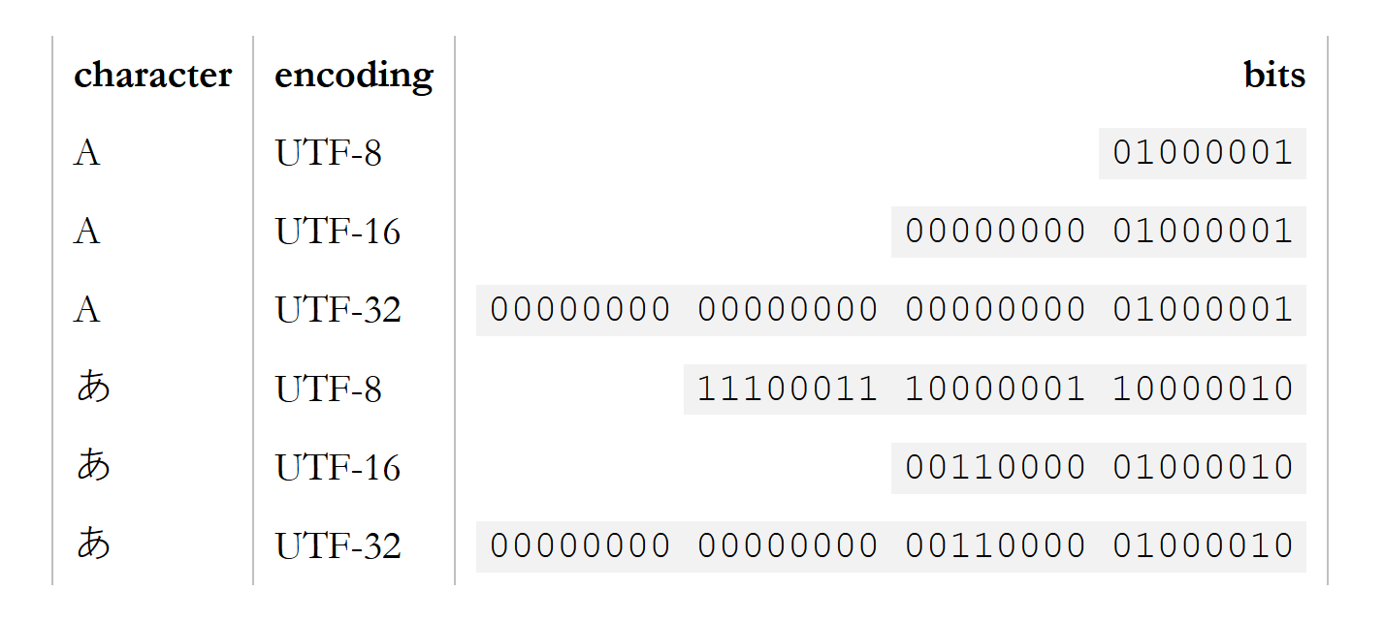
Encoding width, example
Fixed versus variable width Unicode
http://kunststube.net/encoding/ : What every programmer absolutely, positively needs to know about encodings and character sets to work with text

Slide 34
Fonts Mappings
A font might not include a glyph for some character, if so a "default glyph" such as ? or □ is typically displayed
A font doesn't have to respect an encoding, and sometimes it maps glyphs directly to code points.
So, even though the encoding has been interpreted properly, the text may look wrong
Correctly displayed
Vietnamese String
phông chữ và mã hóa
Arial Font
πη⎮νγ χηữ ϖ◊ μ© η⌠α
Symbol Font
phông chữ và mã hóa
Webdings Font

Slide 35
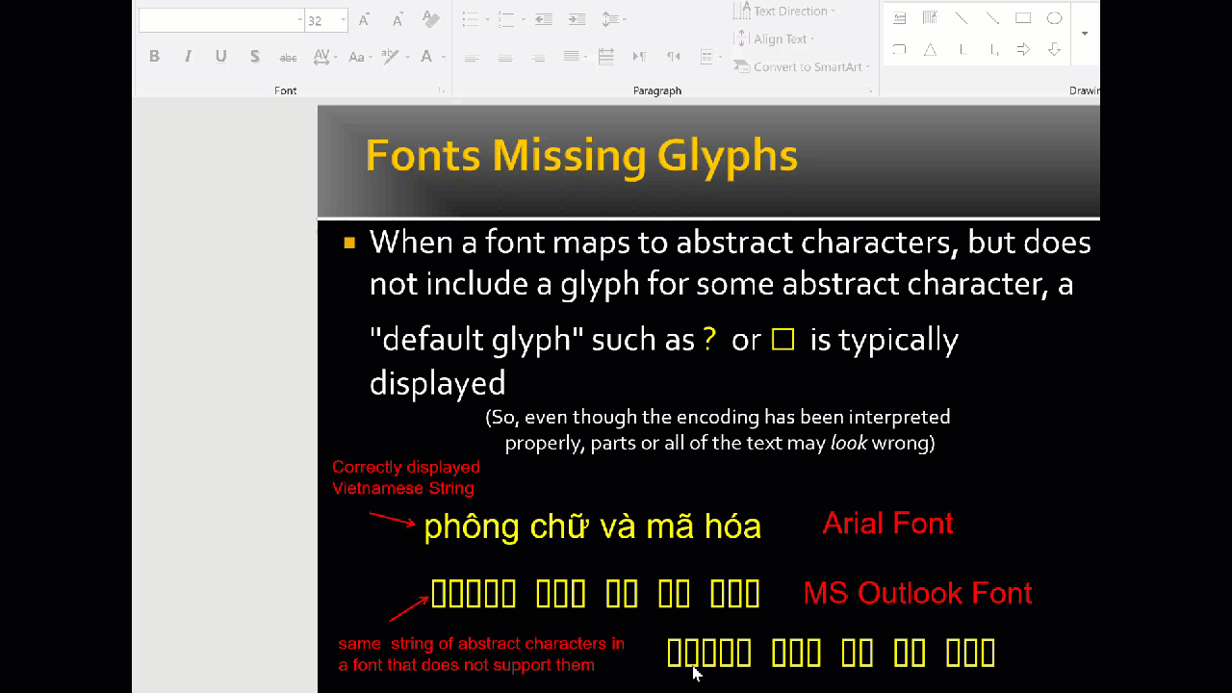
Display issue, not mis-encoding

Slide 36
What can go wrong?
Encoding can be misidentified in a few ways
1. The software guesses the wrong encoding
2. The user specifies the wrong encoding
3. The software does not even try to guess the encoding, but uses the default for the locale or operating system (unbeknownst to the user)
Character
Encoding
Abstract
Character
Glyph
Decimal
Code
Point
KOI-8r
"Russian Capital Letter Zhe"
Ж
1
1
0
1
0
1
1
0
214
Windows
1252
LATIN CAPITAL LETTER O DIAERESIS
Ö

Slide 37
Where encoding/fonts/data can go wrong…
Some technologies map numeric codes directly to glyphs
Examples
Adobe PDF, especially older versions
Some web pages
Motivation
To avoid visual mis-rendering of text
Consequence
Logical order lost, cannot always be re-created
Characters missing codepoints/identity

Slide 38
Unicode normalization
http://localhost:8888/notebooks/Unicode_Normalization.ipynb

Slide 39
Case study: Arabic transliteration
Transliteration: rendering text written in one script (writing system) into another script, usually trying to maintain the approximate sound (not meaning) of the source language
Data Scientist: “The transliteration software is broken, can we get their support number?”

Slide 40

Issues: Arabic transliteration
Software interprets Logical Order but displays Visual Order
Logical Order
Visual Order
ليبيا
ل
ي
ب
ي
ا
L I B I A
A I B I L
NFD normalization alone would produce proper codepoints in backwards order, and subsequently be transliterated as Aibil.
\uFE8E
‎\uFEF4
\uFEDF
‎\uFEF4
\u0628
‎\u0627
‎\uFE92
‎\u0644
\u064A
\u064A
Unicode character database search https://r12a.github.io/uniview/

Slide 41
Logical Order vs. Visual Order
encodings are in logical order, with rules for ordering of diacritics
Software interprets Logical Order but displays Visual Order
Logical Order
Visual Order
ليبيا
ل
ي
ب
ي
ا
L I B I A
A I B I L
spoken or spelling order
visual or reading order

Slide 42
Combining Characters
Diacritics are examples of characters which visually combine with characters around them in the stream
Encoding standards specify an order of operations for combining characters
e + ´ → é
U+0065
U+0301
U+00E9

Slide 43
Ligatures
A sequence of abstract characters may be represented by a single glyph displaying the resulting ligature
abstract characters क + ् + र → ligature glyph क्र.
abstract characters o + e → ligature glyph œ.

Slide 44
Contextual Forms
Some abstract characters are represented with more than one glyph depending on their position in a word
abstract character "Arabic Letter Seen" →
isolated glyph form س
initial glyph form ﺳ
medial glyph form ﺴ
final glyph form ﺲ

Slide 45
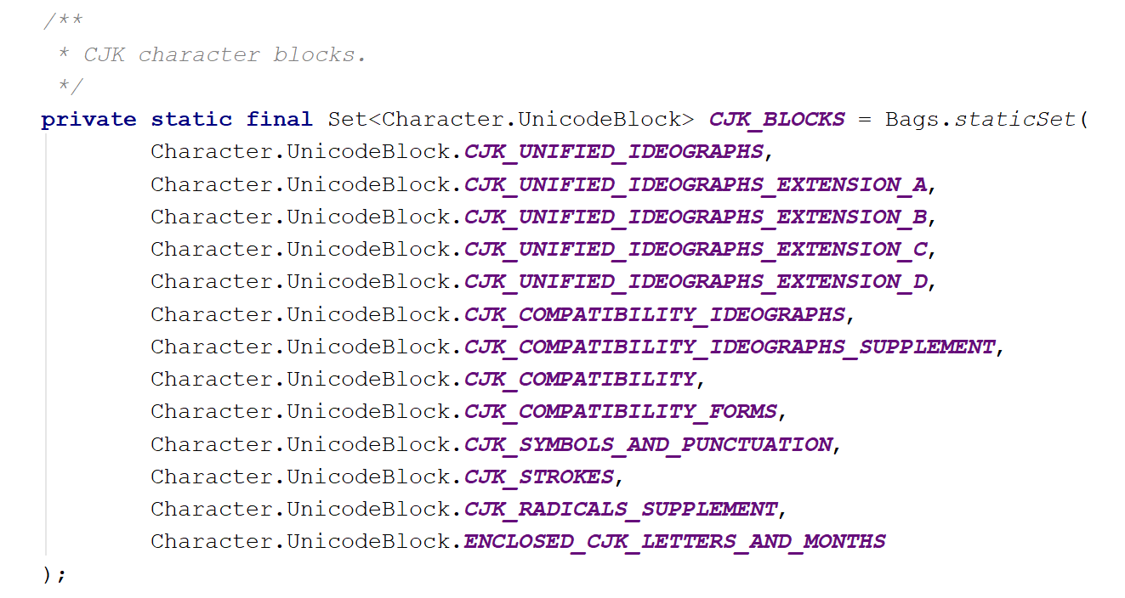
Unicode Blocks v. Writing System
Often, more than one Unicode Blocks are required to cover a writing system (blocks are just sequences of chars, often grouped for compatibility with legacy encodings)
Unicode regular expressions (e.g. in Python's regex, NOT re) include nice things like \p{Han} or \p{Cyrillic} to help
https://www.regular-expressions.info/unicode.html#script

Slide 46
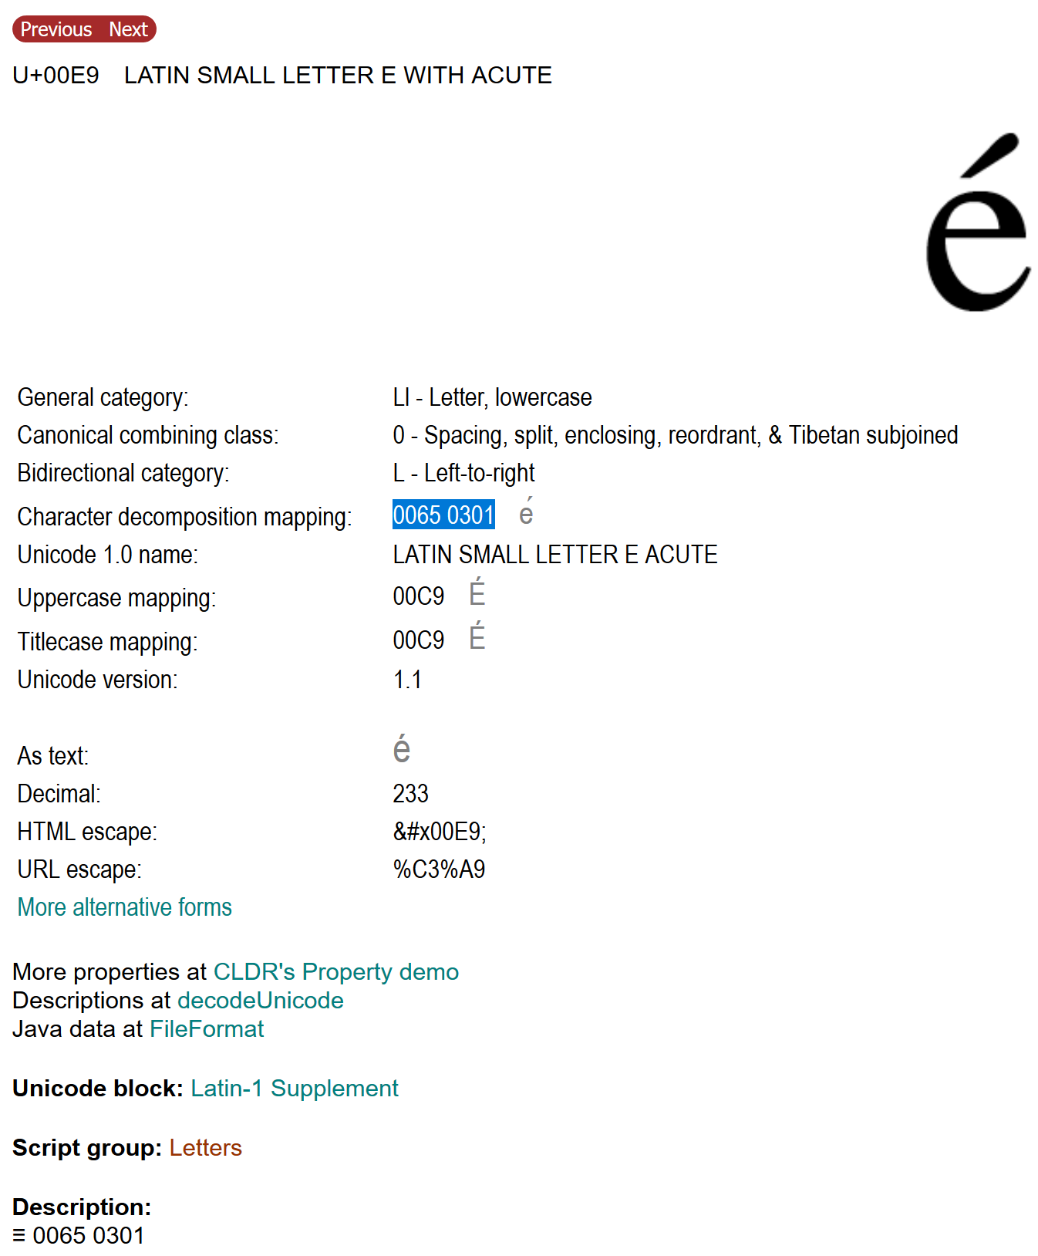
Unicode (de-)composition rules
https://r12a.github.io/uniview/

Slide 47
Unicode Equivalance
Canonical Equivalance
Character(s) assumed to have the same appearance and meaning when printed or displayed
n~ == ñ
Compatability Equivalance
Character(s) may have different appearance but usually the same meaning when printed or displayed
ff sometimes equals ﬀ
https://www.unicode.org/reports/tr15/tr15-18.html

Slide 48
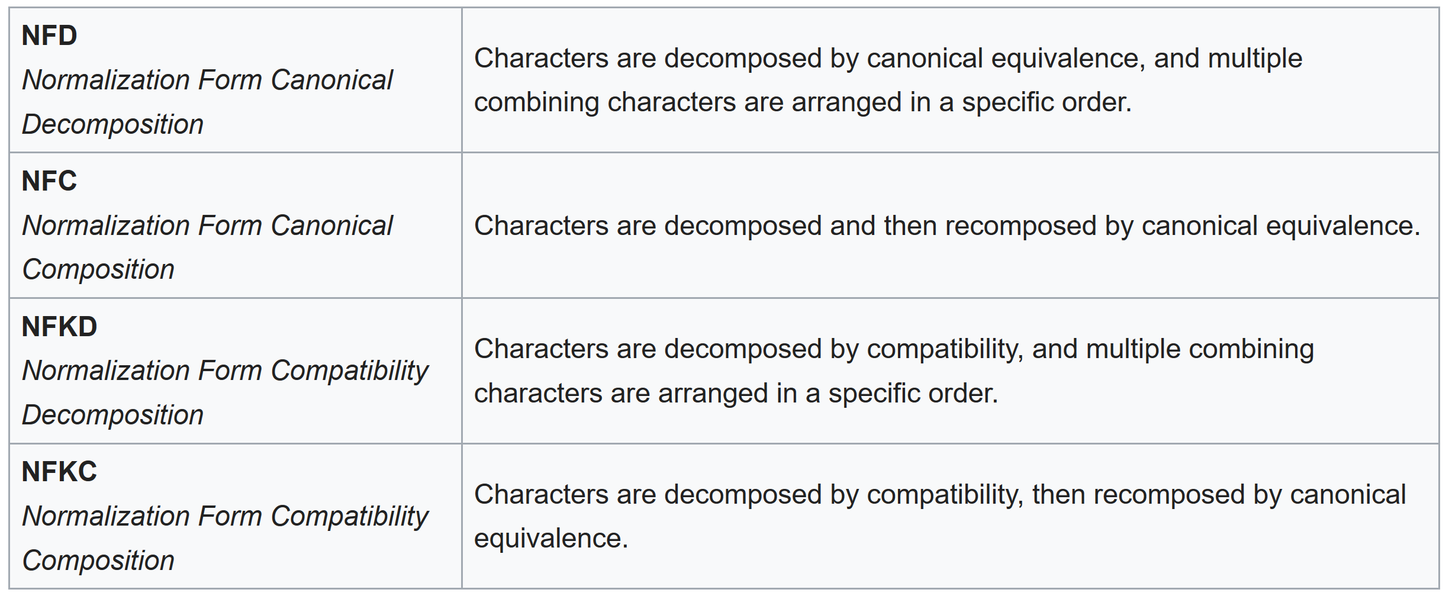
Unicode Normalization Forms
Equivalence plus (de)composition

Slide 49
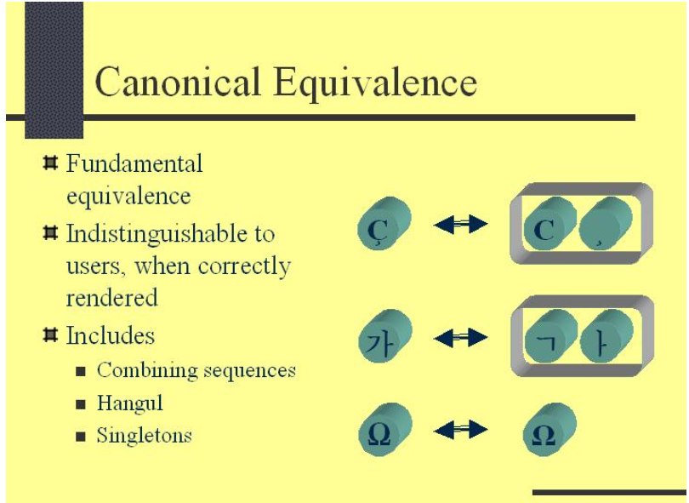
Canonical Equivalance
https://www.unicode.org/reports/tr15/tr15-18.html

Slide 50
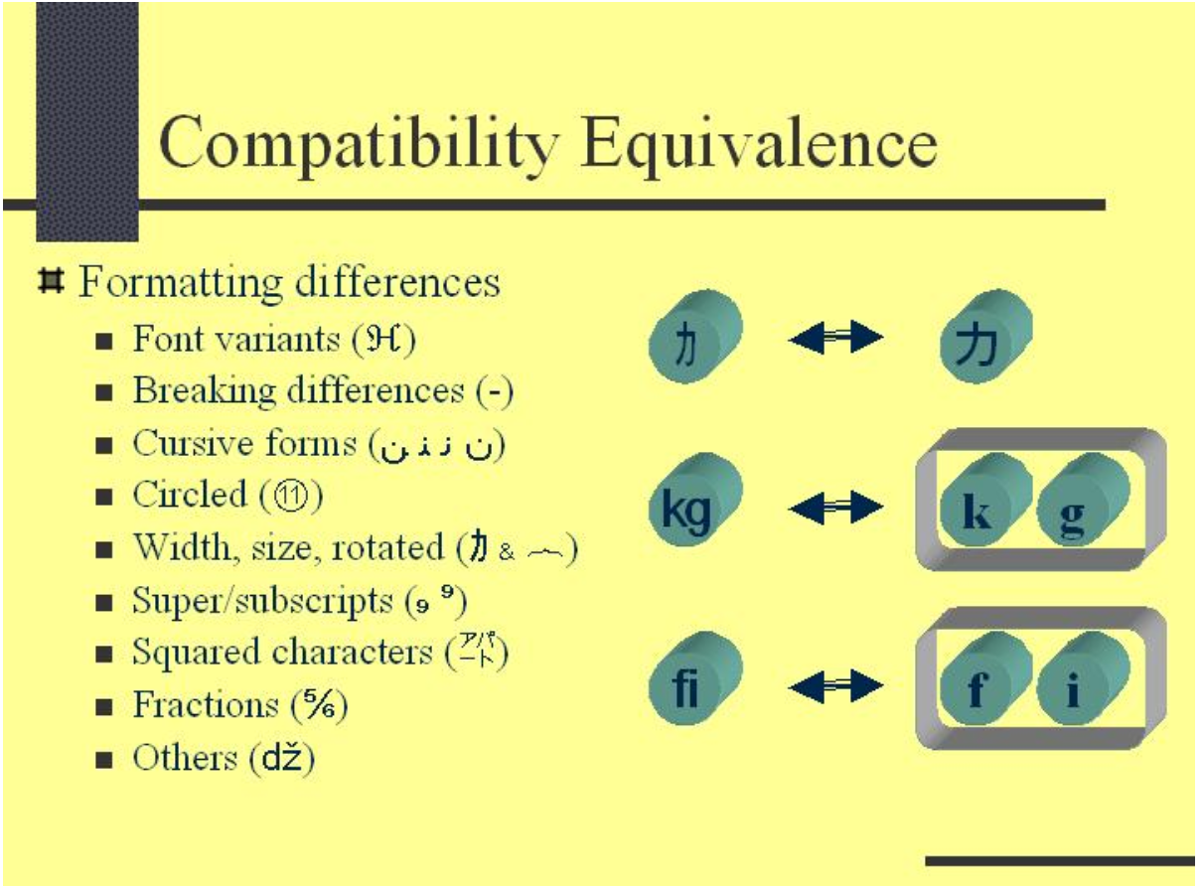
Compatibility Equivalence
https://www.unicode.org/reports/tr15/tr15-18.html

Slide 51
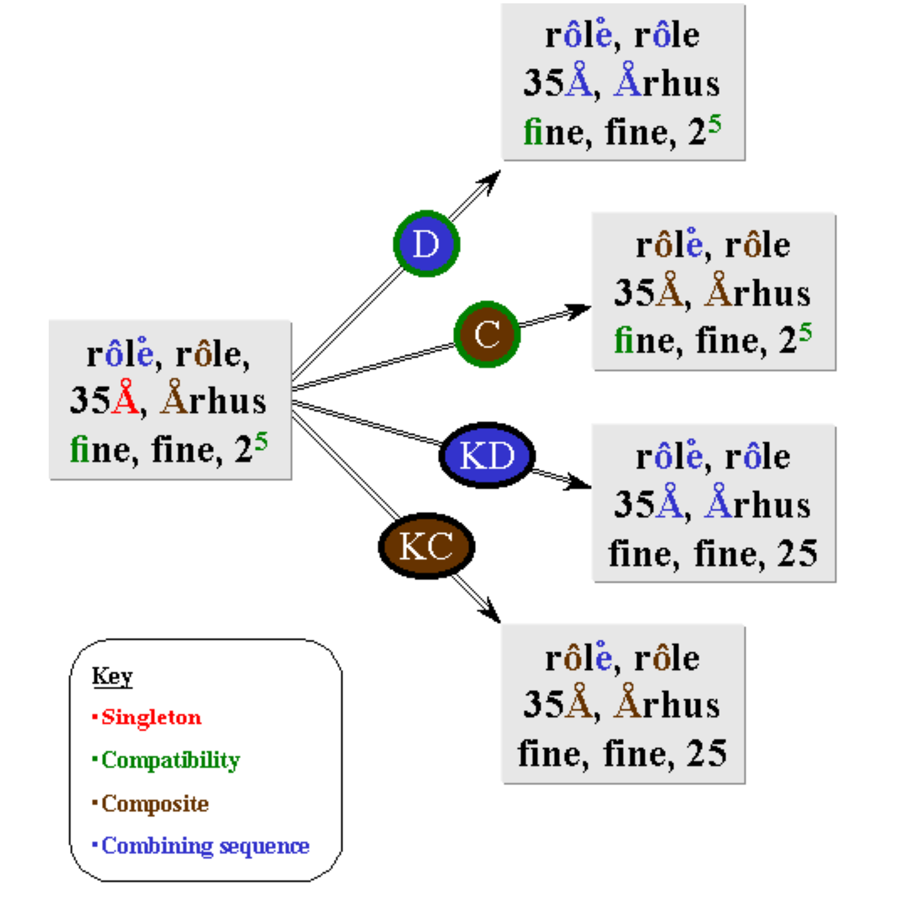
Unicode Normalization Examples
https://www.unicode.org/reports/tr15/tr15-18.html

Slide 52
Case study: Korean text clustering
Text clustering: grouping document collections into subgroups based on some measure of similarity
Data scientist: “I see the same word appearing multiple times in the same cluster – that shouldn’t happen.”

Slide 53
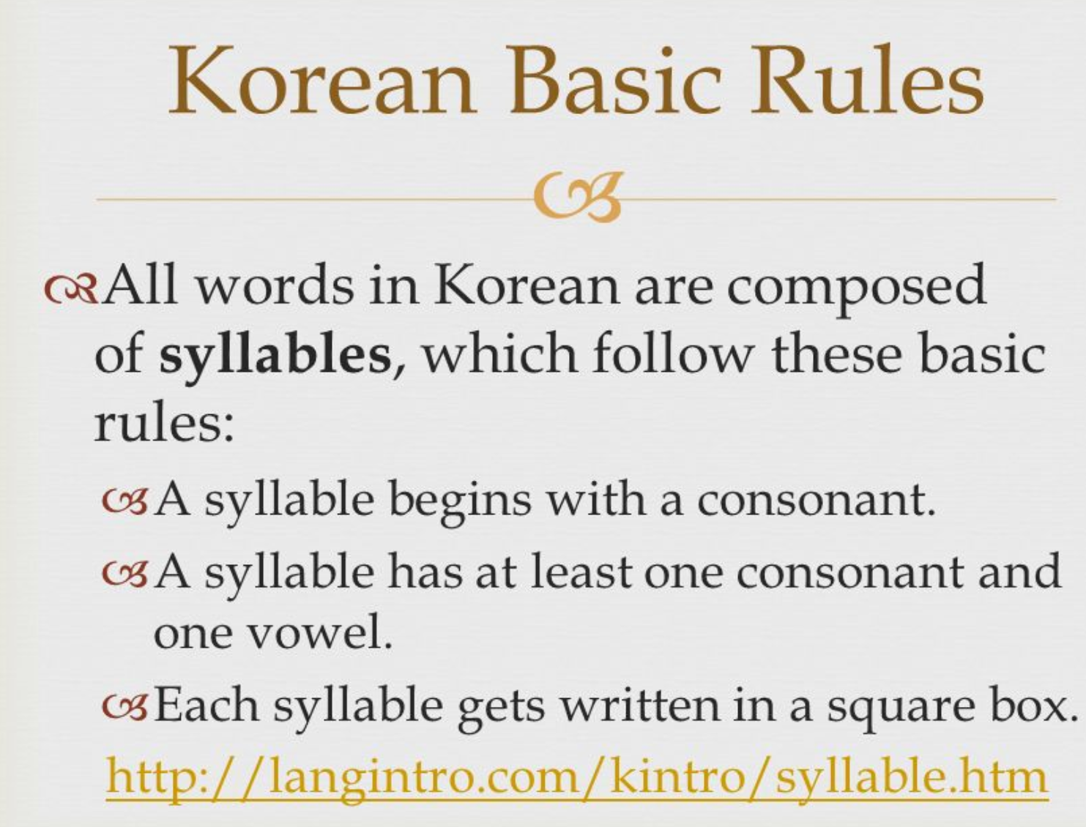
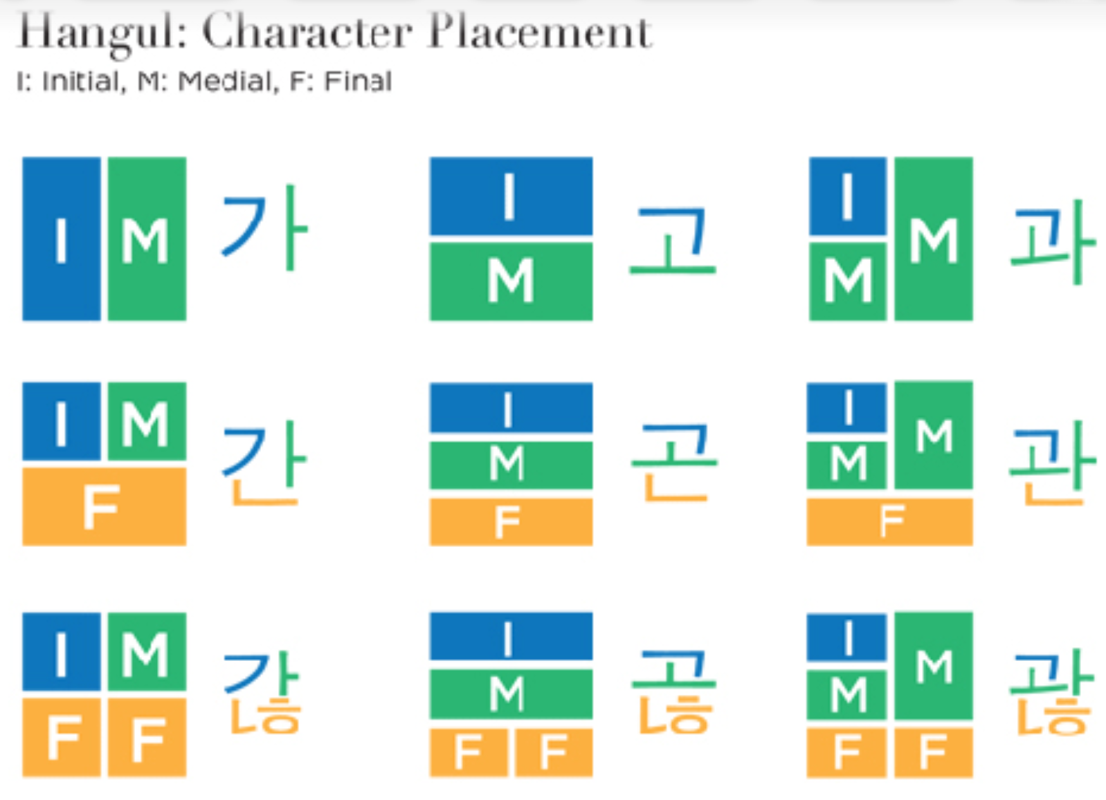
Decomposition Issues: Korean text clustering
https://aminoapps.com/c/btsarmy/page/blog/learn-korean-with-me-lesson-4/eYRE_aYVc3ubR1W4GQ5qzazx6MM6roXoWKb
Unicode Composition (NFC) and Decomposition (NFD) don’t work as one might expect for Korean Hangul. Extra steps are required to fully compose or decompose Korean in the case where compound Jamo are encountered.
Maximal Korean Decompounding and Compounding
See unicode.org/L2/L2006/06310-hangul-decompose9.pdf
L – V – T
http://www.omniglot.com/writing/korean.htm

Slide 54
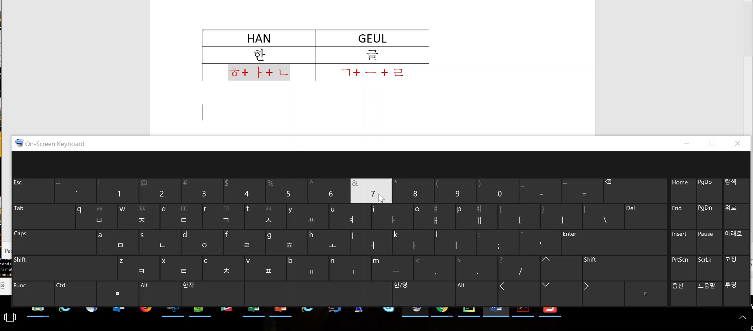
Korean Example
한글
HAN | GEUL
한 | 글
ᄒ+ ᅡ+ ᄂ | ᄀ+ ᅳ + ᄅ

Slide 55

Normalization and debugging tips
String length checks
Invisible (non-printing) characters can cause you to lose a lot of time debugging. A quick string length test can help you determine if two strings that look the same actually are not.
Normalization
Choose a normalization form with your application in mind
Make sure to use the same normalization form when comparing two strings, e.g. index terms v. search terms

Slide 56
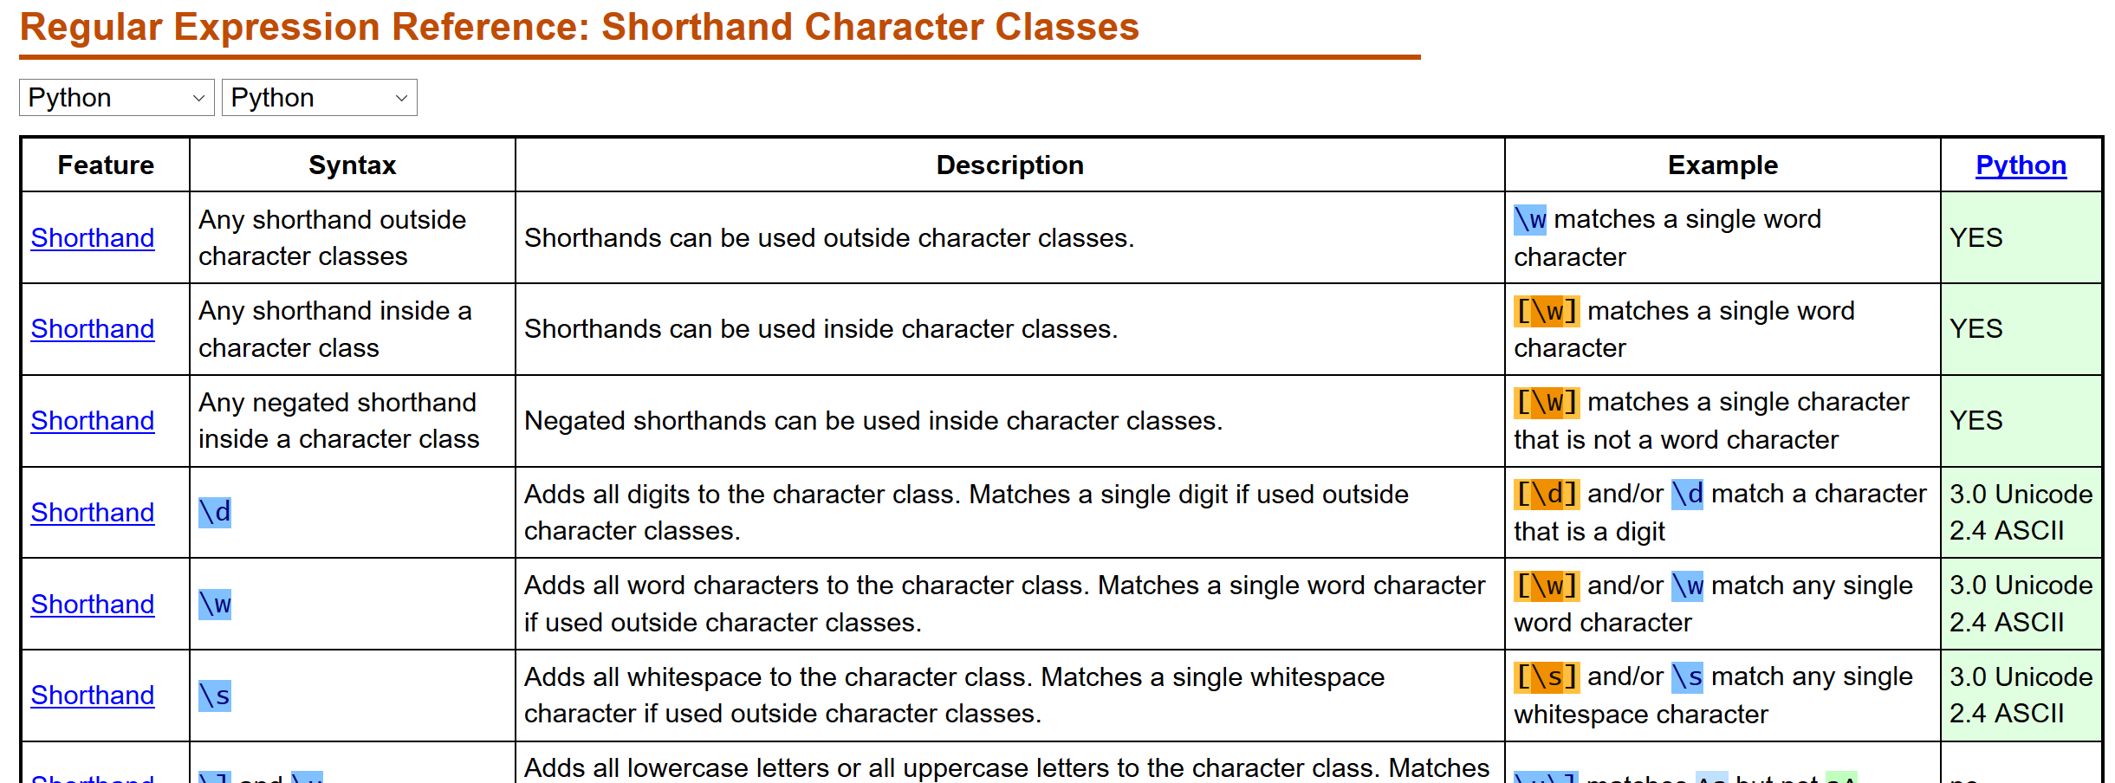
Unicode Regular Expressions
UNICODE REGEXES
TRADITIONAL “ASCII” REGEXES
\p{L} or \p{Letter} : any “letter” from any language.
\w : [a-zA-Z_-]
\p{Z} or \p{Saparator} : any kind of whitespace or invisible separator. .
\s : [\s\t]
https://www.regular-expressions.info/refshorthand.html
https://www.regular-expressions.info/unicode.html

Slide 57
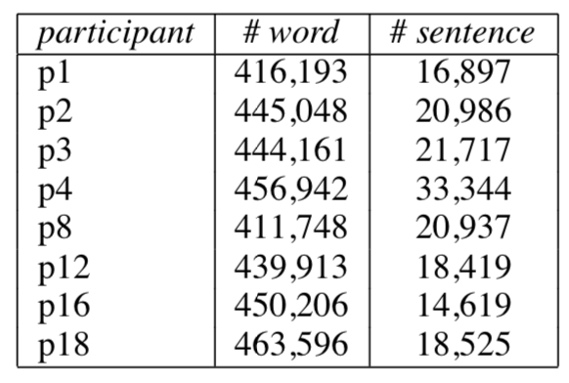
Tokenization
meaning
context
NOTE: when you start using someone else's word embeddings or other model, you need to be sure that your pre-processing matches theirs
discourse
sentence
sentence
Table 1: Total number of words and sentences obtained by 8 tokenizers on a 450,000 size test corpus in the GRACE evaluation.
word
character
Habert et al. (2019) Towards Tokenization Evaluation

Slide 58
Tokenization, sentences and part-of-speech tagging
meaning
http://localhost:8888/notebooks/Tokenization.ipynb
context
discourse
sentence
sentence
word
character

Slide 59
Case study: Arabic proximity search
Proximity search: find documents that contain two terms within a specified distance of one another
e.g. near, within n, slop
Data scientist question: “Why isn’t my proximity search algorithm working for this Arabic data? It works perfectly on my English data!”

Slide 60
Issues: Arabic proximity search
White space tokenization using ASCII regexes
\s versus \p{Zs} (see: https://www.regular-expressions.info/unicode.html)
Normalization (see: http://unicode.org/reports/tr15/)
convert query and text to same Unicode normalization form
White space tokenization insufficient
attached clitics
Word forms
Productive morphology, low recall on exact match
Word order
MSA is VSO (for verbal sentences) and head initial for NPs, while English is SVO and head final for NPs
Proximity operator was directional
Implementation

Slide 61
Case study: Chinese fuzzy term search
Fuzzy term search: Given a list of user terms, find and highlight them in unstructured text, with optional fuzzy matching
Data scientist “Why are recall and precision so low? Users are complaining about the Chinese search, but other languages are working just fine.”
@inproceedings{Qiu2008AMF, title={A Method for Automatic POS Guessing of Chinese Unknown Words}, author={Likun Qiu and Changjian Hu and Kai Zhao}, booktitle={COLING}, year={2008} }

Slide 62
Fuzzy Matching
Edit Distance
Number of insertions, deletions, substitutions to get from one string to another
Levenshtein distance
https://www.python-course.eu/levenshtein_distance.php
Similarity
Overlap between two sets
Jaccard Similarity Coefficient
http://scikitlearn.org/stable/modules/generated/sklearn.metrics.jaccard_similarity_score.html
Dice’s Similarity Coefficient
https://en.wikibooks.org/wiki/Algorithm_Implementation/Strings/Dice's_coefficient

Slide 63
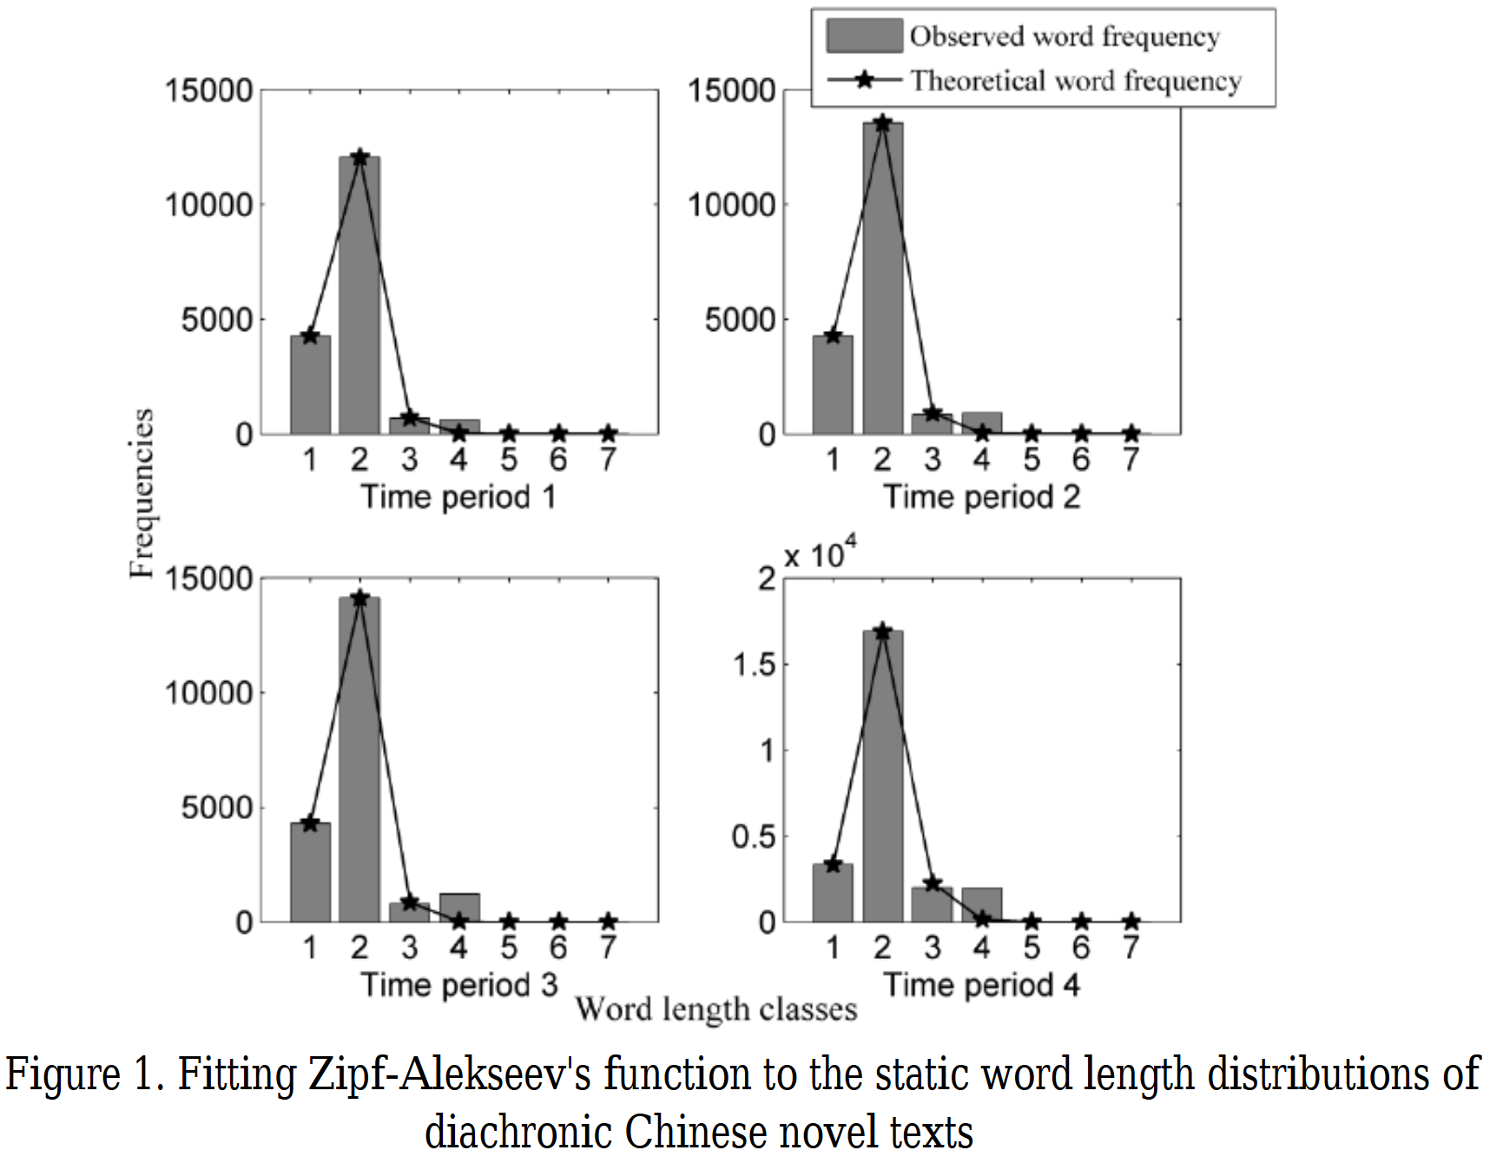
Issues: Chinese fuzzy term search
Short string problem
Possible Approaches
Algorithmic cocktails
Radical-based
Stroke-based
Phonetic (transliteration-based)
Incorporate confusion matrices (IME-specific typographic errors)
http://www.unicode.org/cgi-bin/UnihanRadicalIndex.pl?strokes=1
Chen, Heng & Liu, Haitao. (2014). A diachronic study of Chinese word length distribution. Glottometrics. 29. 81-94.

Slide 64
Some terminology
Collation: rules to determine how data is compared and sorted, usually specific to a combination of language and script
Locale: a group of operating system settings for controlling regional and language based behaviors
https://en.wikipedia.org/wiki/Locale_(computer_software)
\anaconda3\Scripts
the
thé

Slide 65
Case study: Arabic logistic regression classifier
Logistic regression classifier: perform a binary classification of documents to determine in-group / out-group membership.
Data scientist: “I don’t understand why the output isn’t more accurate and useful to the linguists. I build my document-term matrix by splitting on whitespace with a regex (\s+), eliminating words where len<=3, filtering a small list of longer stop-words, and using a list of known in-group terms as features”

Slide 66
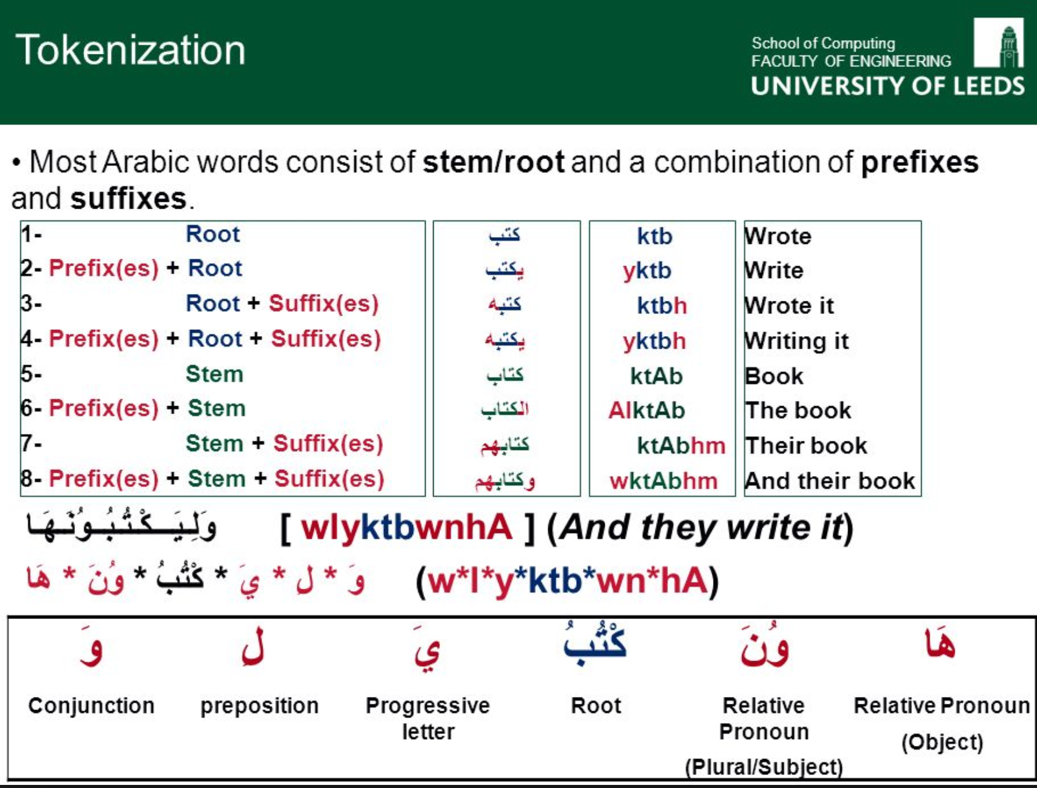
Case study: Arabic logistic regression classifier
Issues
Model / matrix size
Logistic regression does not function well as a classifier when the matrix contains too many rows or columns. One solution, perform document clustering and create a topic-term matrix
White-space tokenization/stemming
ASCII whitespace regex \s+ should be replaced with \p{Zs}
More sophisticated tokenization required and/or light stemming to separate attached clitics
Text normalization required
Stopword filter len(<=3) not appropriate for Arabic

Slide 67
Case study: English sentiment analysis
Sentiment Analysis: classify content according to the author’s opinions or emotions toward some object, event
Data Scientist: “I’m getting strange symbols and bad handling of emoticons from the tokenizer. I need some normalized representation of the emoticons and emoji. Emojis play an important role in determining sentiment”.

Slide 68
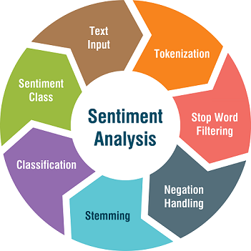

Issues: English sentiment analysis
Challenges
Old tokenizer
Multiple ways to represent same emotion
Original form may provide authorship clues
Emoji Unicode | EMOJI Unicode Trimmed | LEN_Unicode | EmojiNorm | Aliases | Tags | Description | Supports Fitzgerald | Semaphoric Type
0:) | 0:) | 3 | 😇 | angel |  | Angel, saint, innocent |  | EMOTICON
0:‑) | 0:‑) | 4 | 😇 | angel |  | Angel, saint, innocent |  | EMOTICON
0:03 | 0:03 | 4 | 😇 | angel |  | Angel, saint, innocent |  | EMOTICON
0:‑3 | 0:‑3 | 4 | 😇 | angel |  | Angel, saint, innocent |  | EMOTICON
0;^) | 0;^) | 4 | 😇 | angel | angel_winking | Angel, saint, innocent |  | EMOTICON
O:) | O:) | 3 | 😇 | angel | angel_smiling | Angel, saint, innocent |  | EMOTICON
O:‑) | O:‑) | 4 | 😇 | angel | angel_smiling | Angel, saint, innocent |  | EMOTICON
👼 | 👼 | 2 | 😇 | angel |  | baby angel | true | EMOJI
https://qph.fs.quoracdn.net/main-qimg-8c1c4d5447ad8429e847b2c7aa9f7246
Keras pyTorch
https://www.media.mit.edu/projects/deepmoji/overview/

Slide 69
Issues: Emoji are in high planes
Surrogate pairs
UTF-16 can encode over 65,000 characters can be encoded (2 ^16^ = 65,536) (Basic multilingual plane)
BUT THAT’S NOT ENOUGH
Unicode planes were invented to create space for additional characters, including emoji , Chinese compatibility characters, etc.
Characters on higher planes are described with two 16 bit characters called surrogate pairs, the individual members should not be interpreted separately

Slide 70
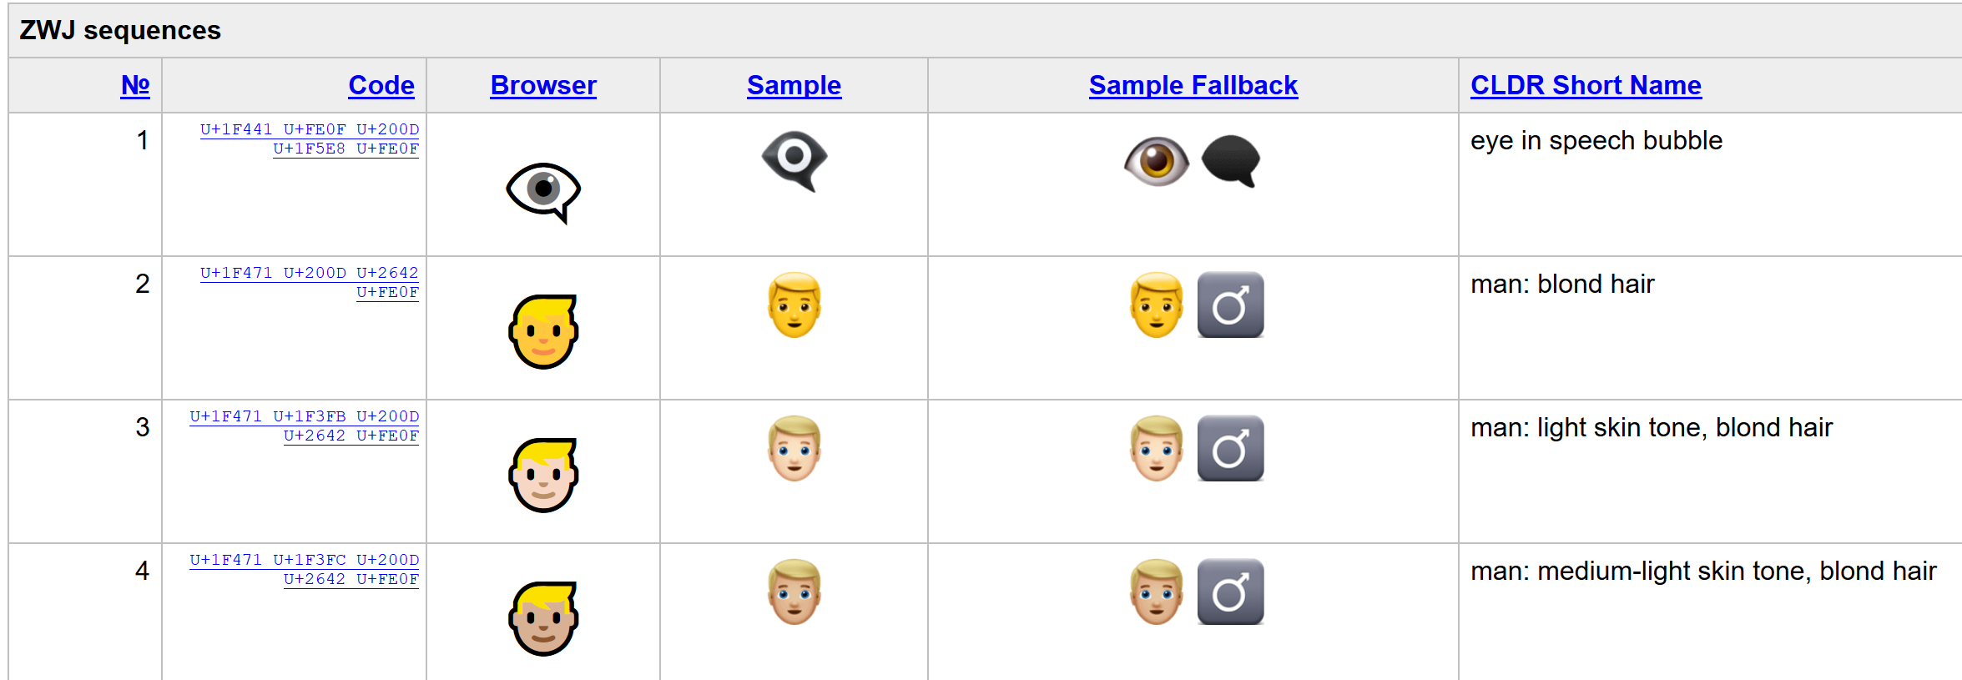
Issues: Emoji can be complex
Emoji modifiers
http://unicode.org/emoji/charts/emoji-sequences.html#modifier_sequences
Skin tones (Fitzpatrick Scale)
Flags
Based on 2 letter ISO codes
Zero-width joiner sequences
https://unicode.org/emoji/charts/emoji-zwj-sequences.html
Syntax???
http://www.icge.co.uk/languagesciencesblog/?p=1511

Slide 71
Fun with emojicons ☺
EMOJI Unicode | LEN_Unicode | EmojiNorm | Aliases | Tags | "EXPRESSION" | Description | Supports Fitzgerald | Semaphoric Type | SYMBOL_TYPE
;‑] | 3 | 😉 | winking |  | WINKING | Wink |  | EMOTICON | HUMAN
;^) | 3 | 😉 | winking |  | WINKING | Wink |  | EMOTICON | HUMAN
;D | 2 | 😉 | winking |  | WINKING | Wink |  | EMOTICON | HUMAN
😉 | 2 |  | wink | flirt | WINKING | winking face | false | EMOJI | HUMAN
😮 | 2 |  | open_mouth | surprise ; impressed ; wow | WINKING | face with open mouth | false | EMOJI | HUMAN
(ーー;) | 5 |  | worried |  | WORRIED | Worried |  | KAOMOJI | HUMAN
<`ヘ´> | 5 |  | worried |  | WORRIED | Worried |  | KAOMOJI | HUMAN
✨ | 1 |  | sparkles | shiny |  | sparkles | false |  | STAR
(@_@) | 5 |  | amazed |  |  | Amazed |  | KAOMOJI | HUMAN
(^.^) | 5 |  | laugh |  |  | Normal laugh |  | KAOMOJI | HUMAN
(^J^) | 5 |  | laugh |  |  | Normal laugh |  | KAOMOJI | HUMAN
(＾ｖ＾) | 5 |  | smile |  |  |  |  | KAOMOJI | HUMAN
(°))<< | 6 | 🐟 | fish |  |  | Animal, Fish |  | ICON | ANIMAL, FISH
(・へ・) | 5 |  | worried |  |  | Worried |  | KAOMOJI | HUMAN
!(^^)! | 7 |  | amazed |  |  | Amazed |  | KAOMOJI | HUMAN

Slide 72
Unicode in Python
https://docs.python.org/3/howto/unicode.html
http://python-notes.curiousefficiency.org/en/latest/python3/text_file_processing.html
https://docs.python.org/3.1/library/unicodedata.html

